Slide 1

The Big Mountain Resort
Underpricing

Slide 2
The Big Mountain Resort wants to know if it is underpricing its admission tickets and what resort features would add to the market ticket cap.

Slide 3
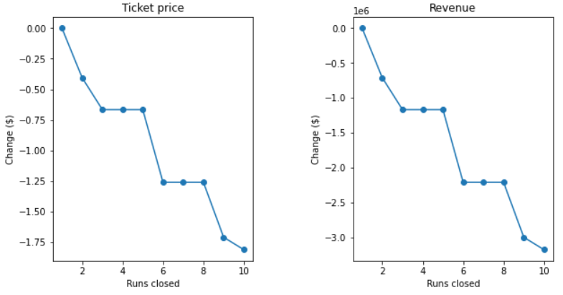
Cut at least two runs and increase the vertical drop by adding an additional run to a point 150 feet lower down
Increasing vertical drop by 150 will enable The Big Mountain Resort to add $2.00 to its admission price. This will result in a projected seasonal increase of $3,474,638 to revenue.
(Right) One can see the projected decrease in revenue of removing runs. With the addition of the new lower run, The Big Mountain Resort could remove 2 other runs without a hurting pricing.

Slide 4
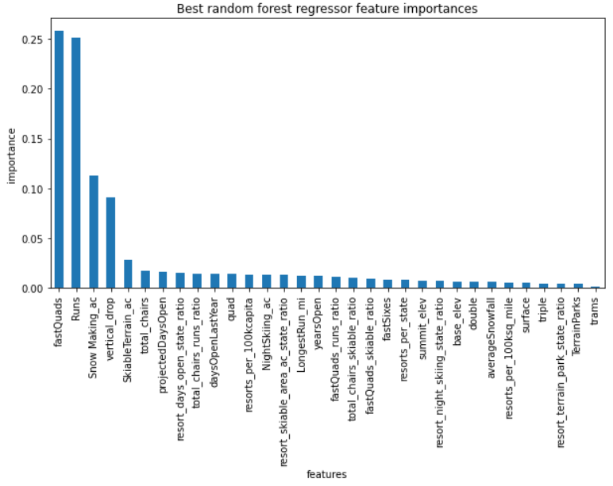
Feature importance
As you can see, there are 4 primary resort features that influence ticket pricing: fast quads, runs, snow making, and vertical drop. Increasing fast quads might also be a good option to increase projected revenue. Because operational costs are not factored into this graph, it is an imperfect representation of possible economic performance.

Slide 5
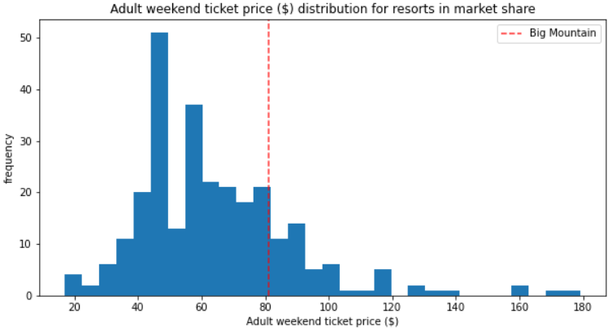
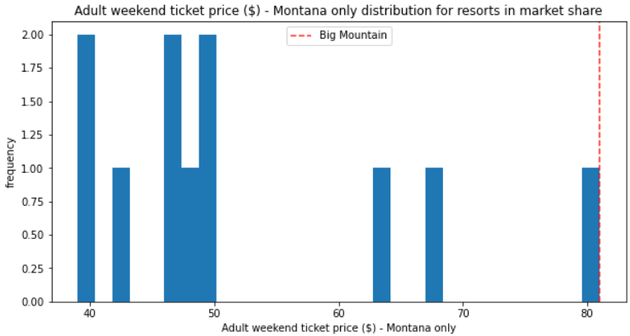
Big Mountain Resort pricing comparison
Big Mountain is near the mean of the market share countrywide.
Big Mountain is at the top of the market share statewide.

Slide 6
Current Pricing
According to the model, The Big Mountain was expected to be charging about $96 for admission as opposed to the current price set at $81. Given the margin of error at $10.39, assuming other resorts are charging in accordance with market value The Big Mountain could increase admission price without changing anything.

Slide 7
Conclusion
The Big Mountain resort can increase expected revenue by increasing vertical drop and cutting number of runs. Other features such as fast quads or the cutting of less important features might also decrease expenditure while increasing profit.

